Slide 1
Laptop Store Billing System
By Aishwarya & Priyanka
Notes:
ID=d924773e-9a16-4d6d-9803-8cb819e99682 Recipe=text_billboard Type=TextOnly Variant=0 FamilyID=AccentBoxWalbaum_Zero

Slide 2
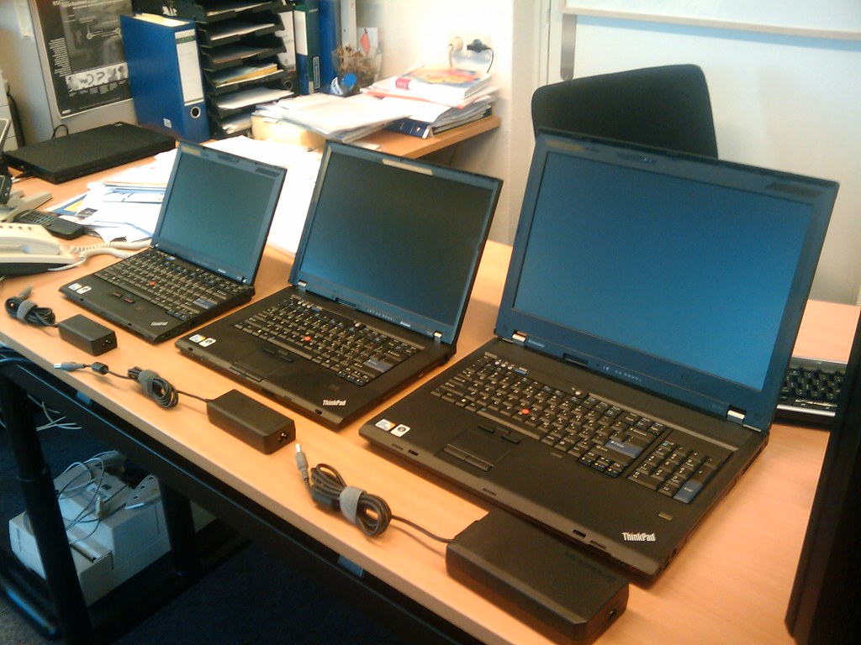
Index
Introduction
Objectives
Scope
Hardware and Software
System Design
Layout of the website
Limitations
Conclusion
Bibliography

Slide 3
Introduction
In today's rapidly evolving technological landscape, efficient management of inventory and streamlined customer transactions are crucial for the success of any retail business, including computer stores. The advent of computerized systems has revolutionized the way businesses operate, offering sophisticated solutions to address the challenges of inventory management and billing processes. In line with this, our project aims to develop a comprehensive computer store billing system that not only simplifies inventory management but also enhances the overall customer experience.

Slide 4
Scope
Inventory Management
Stock Monitoring
Customer Billing System
Sales Reporting and Analysis
User Management and Security
Scalability and Flexibility
User Training and Support

Slide 5
Hardware Specification
Processor: Intel Core i3 or equivalent (or AMD Ryzen 3)
RAM: 4 GB
Storage: 500 GB hard drive (or equivalent solid-state drive)
Operating System: Windows 7 or later (64-bit recommended)
Display: Standard resolution monitor
Other: Keyboard, Mouse, Internet connection (optional for online updates)

Slide 6
Software Specification
Java Development Kit (JDK) 11 or later
Apache NetBeans IDE 12 or later Web Server:
Apache XAMPP (version compatible with chosen JDK) Database (Optional):
MySQL (included with XAMPP) - for storing inventory data (if applicable)

Slide 7
Advantages
Efficient Inventory Management
Improved Customer Service
Insightful Reporting
Enhanced Security
Scalability
Time and Cost Savings
Customization

Slide 8
System Limitations
Initial Cost
Learning Curve
Technical Issues
Data Security Concerns
Dependency on Technology
Integration Challenges
Limited Customization

Slide 9
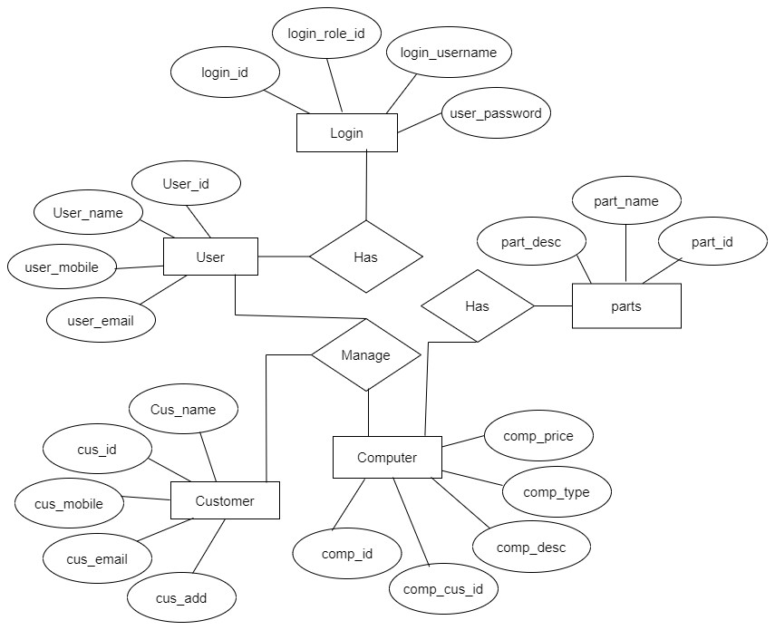
ERD

Slide 10
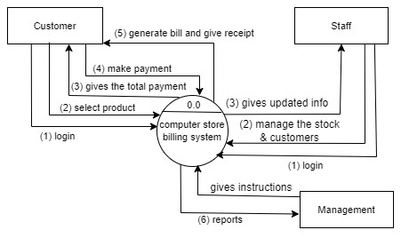
DFD

Slide 11
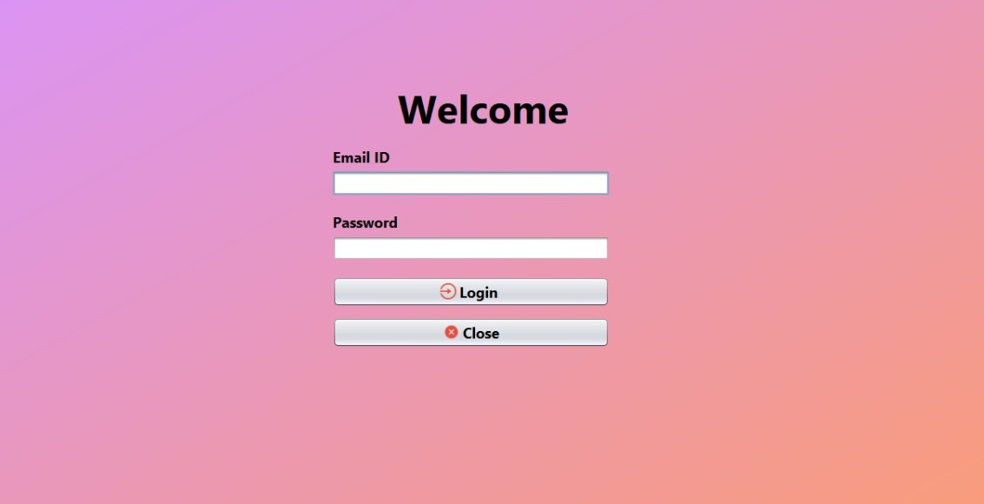
LOGIN PAGE

Slide 12
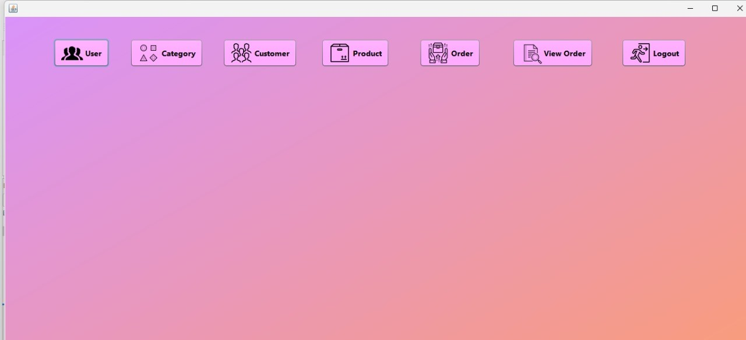
HOME PAGE

Slide 13
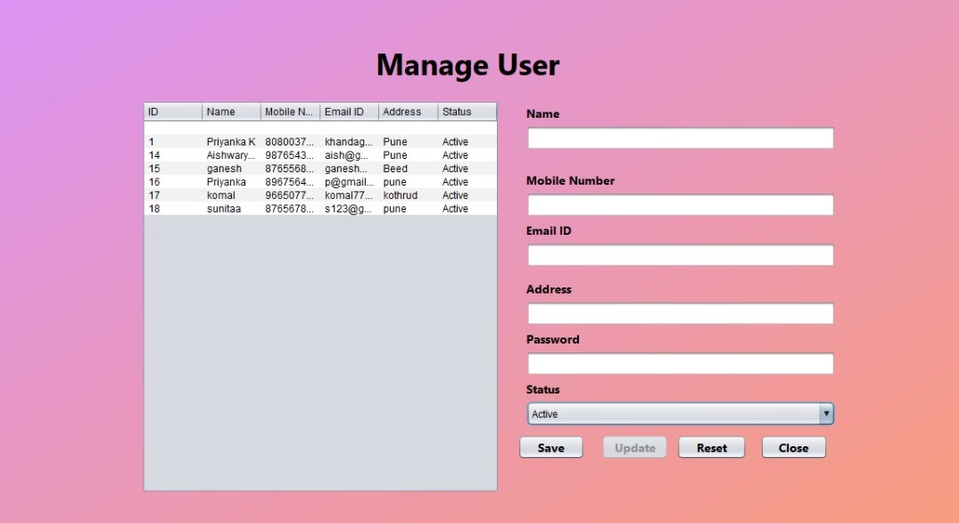
LAYOUT OF THE WEBSITE

Slide 14
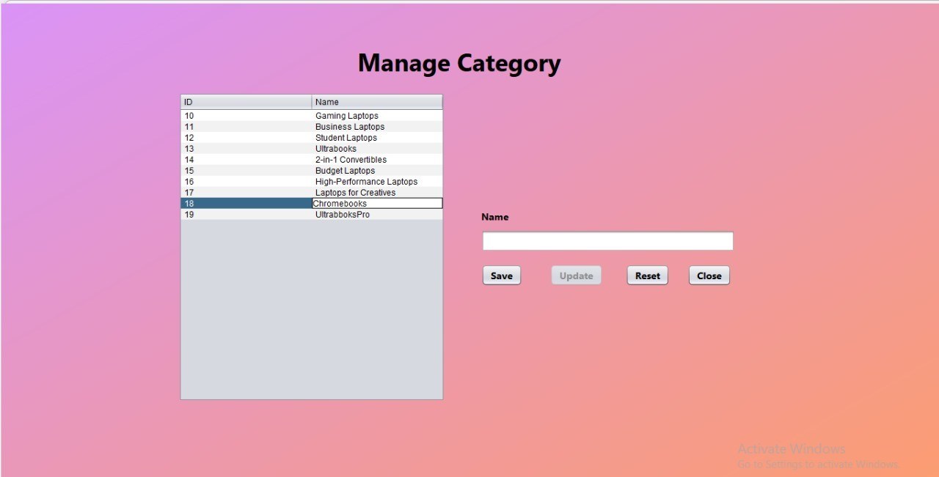
MANAGE CATEGORY PAGE

Slide 15
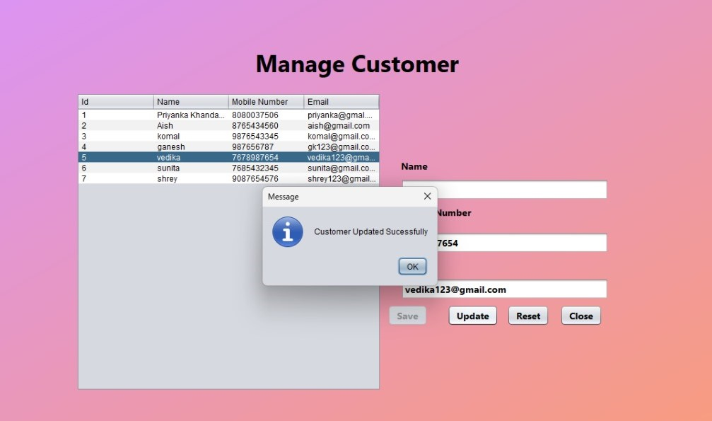
MANAGE CUSTOMER PAGE

Slide 16
MANAGE USER PAGE

Slide 17
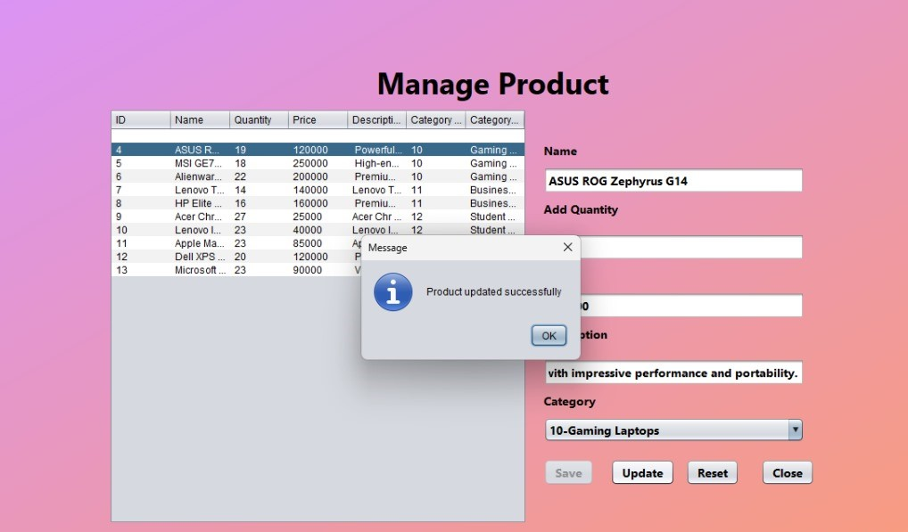
MANAGE PRODUCT PAGE

Slide 18
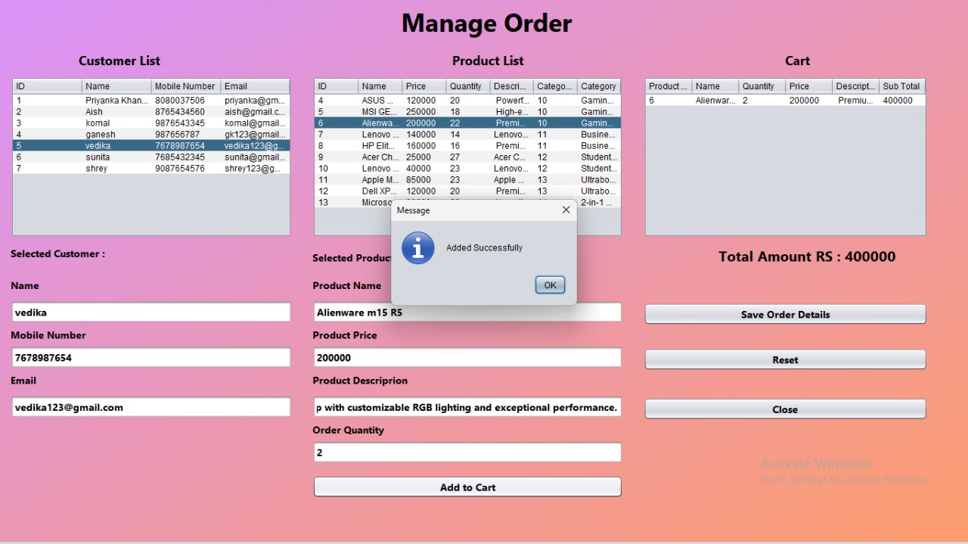
MANAGE ORDER PAGE

Slide 19
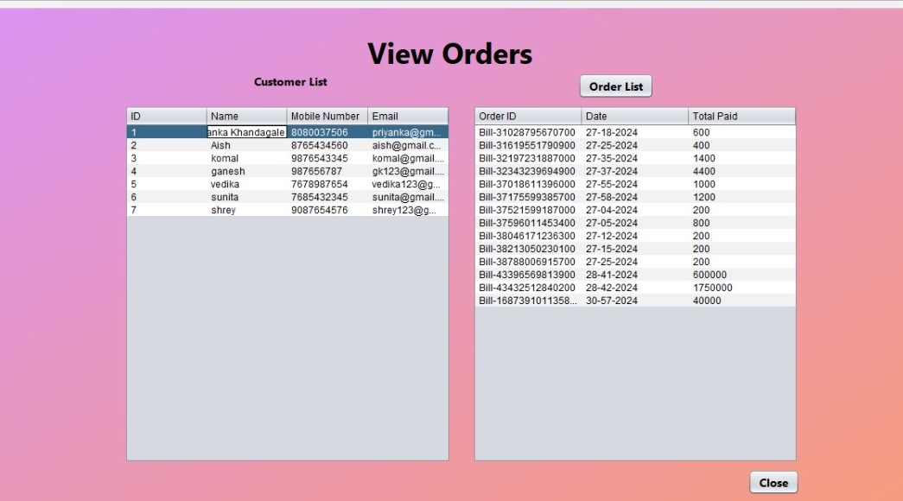
VIEW ORDERS PAGE

Slide 20
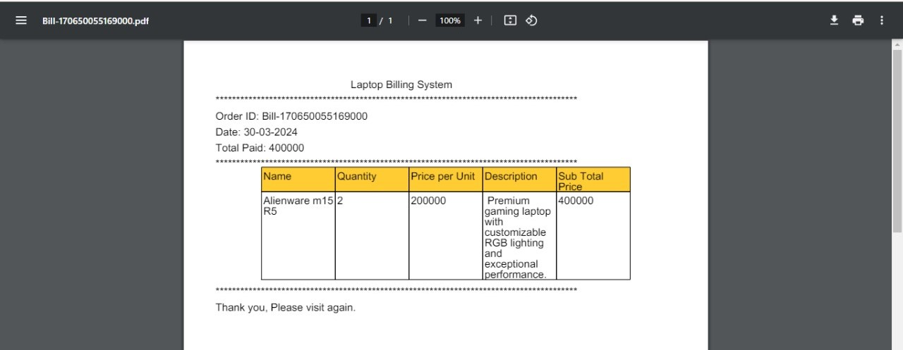
RECEIPT PAGE

Slide 21
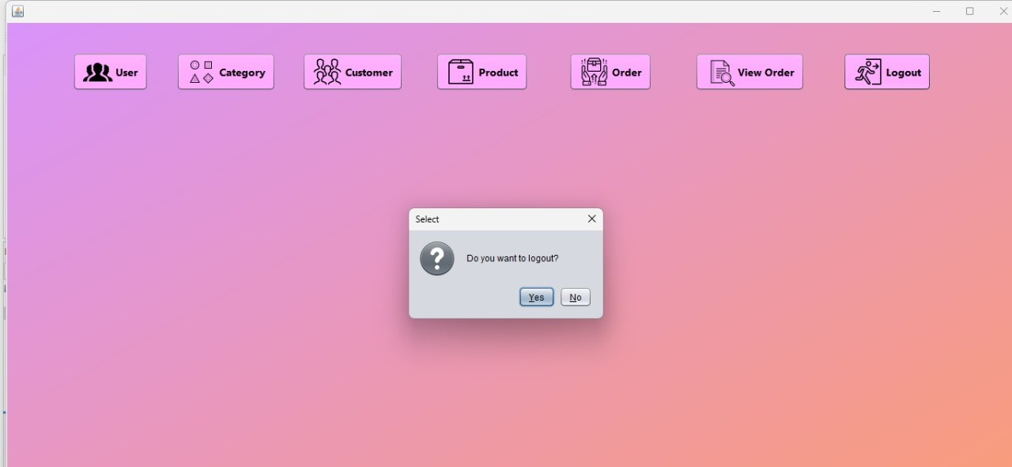

Slide 22
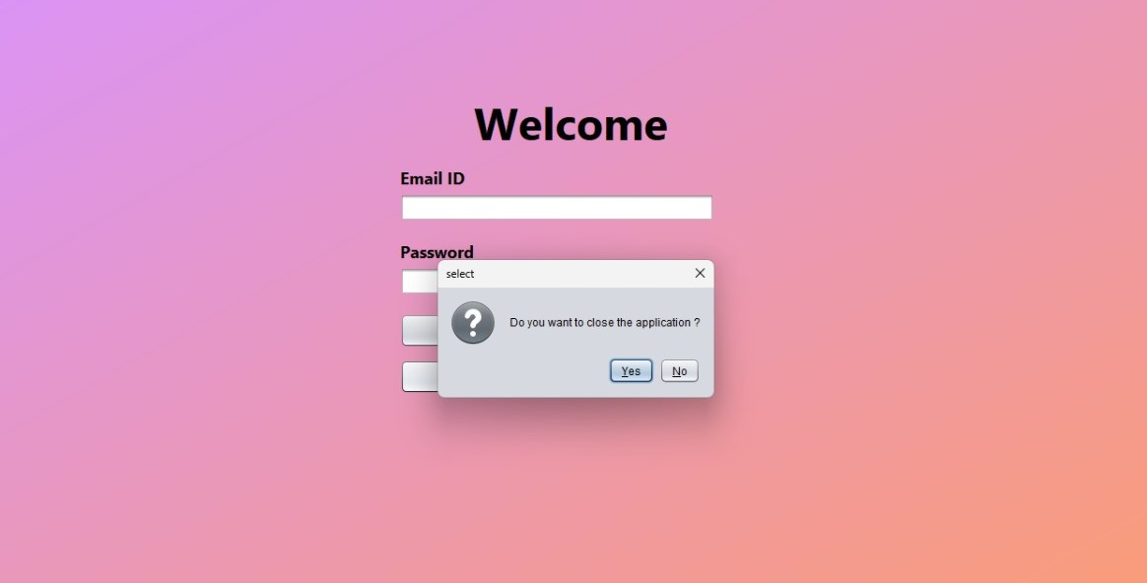

Slide 23
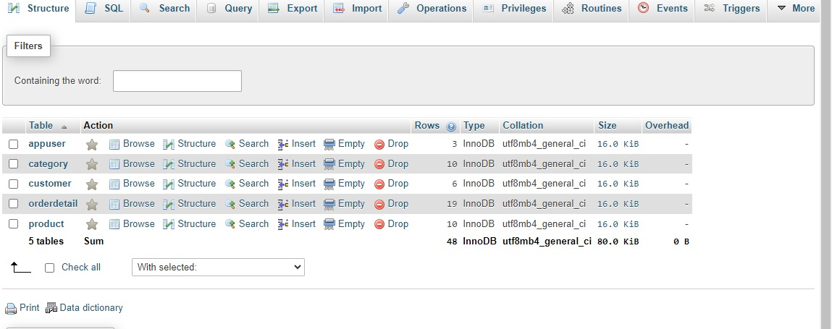

Slide 24
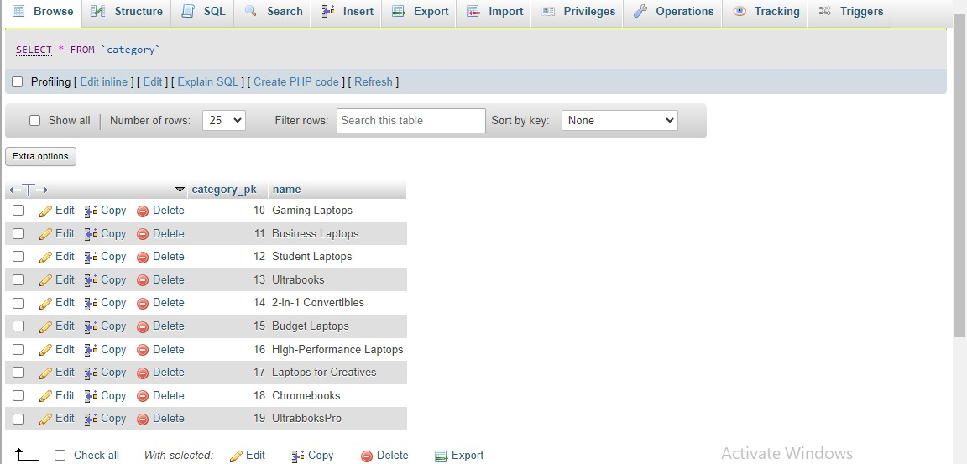

Slide 25
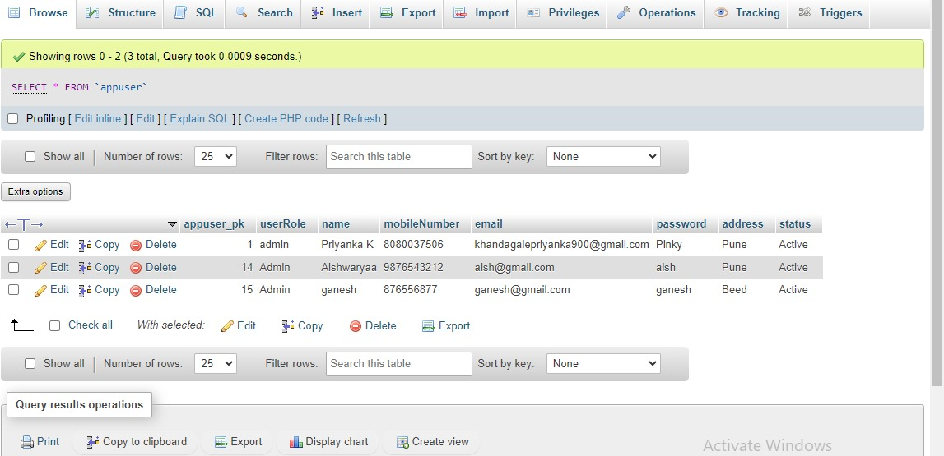

Slide 26
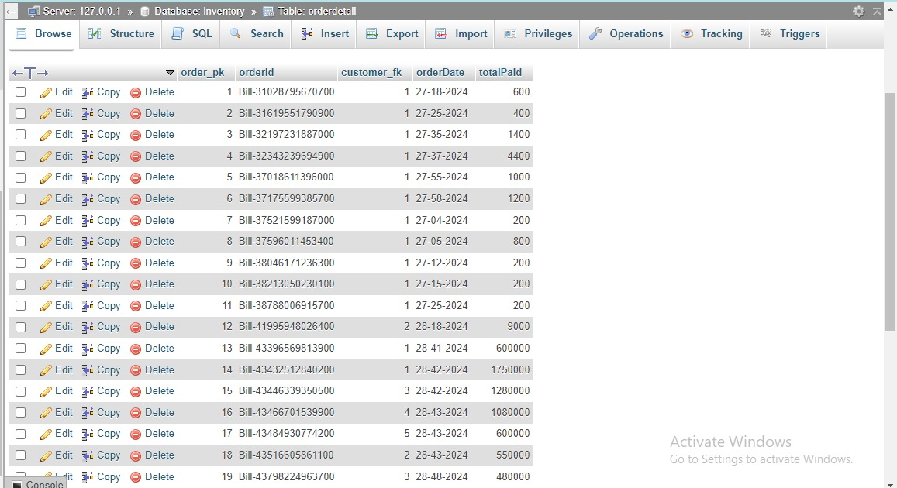

Slide 28
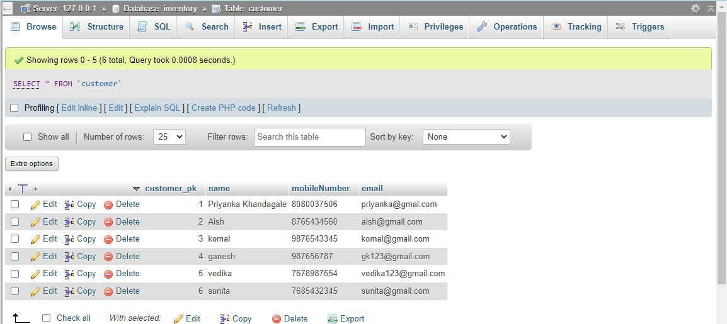

Slide 29
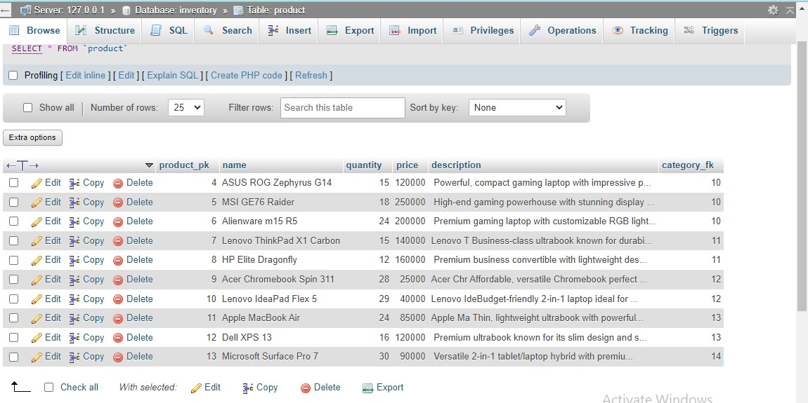

Slide 31
Conclusion
In conclusion, the development of the computer store billing system represents a significant step towards modernizing and optimizing operations within the store. By implementing this system, the store aims to streamline inventory management, enhance customer satisfaction, and drive business growth. Through efficient tracking of inventory, seamless billing processes, and insightful sales reporting, the system empowers store owners to make informed decisions and adapt to changing market trends.
Furthermore, the emphasis on security, scalability, and user support ensures that the system meets the highest standards of reliability, adaptability, and usability. Leveraging hardware and software specifications, including the utilization of XAMPP server technology, the project sets a solid foundation for the successful implementation and operation of the billing system.

Slide 32
Bibliography
Java Development:
Flanagan, D. (2022). Head First Java (3rd ed.). O'Reilly Media. (A beginnerfriendly introduction to Java)
Althoff, P., Farley, D., & Moore, J. (2009). Java Persistence with Hibernate (2nd ed.). Manning Publications. (For developers using Hibernate for database persistence)
Oracle Corporation. (n.d.). Java Tutorial. (Official Java tutorials from Oracle)
Computer Store Billing Systems:
Alexander, M. (2019). Designing and Implementing a Point-of-Sale System for a Retail Store. (Discusses designing a point-of-sale system for a retail store)

